Slide 1
Project 1: Mastermind
Elliott C
Barcelona, October 2019
Notes:
* Title of the project + Student name
* Description and rules of your game
* Workflow
* Challenges you encountered during the process
* Learnings
* Possible future improvements
* Demo of the game (remember to save time for it)

Slide 2
What’s it all about and those all important rules
One player (computer) selects a secret combination of coloured pegs. They can use the same colour more than once
The second player (user) needs to guess that combination
Feedback is provided after each guess
For each correct colour that appears in the code but incorrect position 1 WHITE peg awarded
For each correct colour and position combination 1 BLACK peg awarded
The feedback from the prior guess should help inform the next guess
Second player only has a fixed number of guesses

Slide 3
Workflow
Welcome the player to the game and explain how it works
Computer to generate the ‘code’ of 3 numbers from a choice of 5.
Represents 3 colours from choice of 5, repeats are allowed
Ask the user to input the colour guess of their first position
Repeat for 2nd and 3rd positions
Colours translated into numbers
After all guesses inputted, the player’s guess will be compared to the CPU’s code
Assess current guess and provide feedback
If the user guess matches computer generated code then we have a winner (and stop game)
Award white and black pegs
If exact match not found then user asked to enter their next guess
Repeats for 5 rounds

Slide 4
Challenges
Getting to know the game!
Branched logic
Winner, white peg(s), black peg(s)
Resetting WHITE/ BLACK peg feedback at the beginning of next guess
Too many functions!
Terminating colours

Slide 5
Learnings
“Measure twice, cut once”
Spend more time planning
Think about the specific functions before coding
Use the new skills learned during the classes

Slide 6
Future Improvements
Store functions in UTILS\FUNCS folder
Increase the length of the code that needs to be cracked
Allow user to define the length of code
Improve visuals
i.e. for WHITE/ BLACK peg feedback
Use more efficient code
Display probability of success before each guess

Slide 7
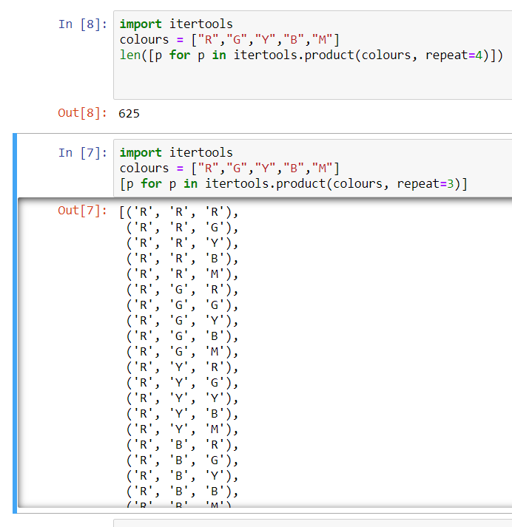
itertools

Slide 8
Demo

